Slide 1

Digital Twin of an Induction Motor: Fault Analysis & Predictive Maintenance
Group Members: (CMS)
Malik Abubakar (340894)
Muhammad Ahmed Mohsin (333060)
Danial Ahmad (331388)
Muhammad Umer (345834)
Syeda Fatima Zahra (334379)
Course Instructor: Dr. Shahzad Younis
Lab Instructor: Mr. Ali Khalid

Slide 2
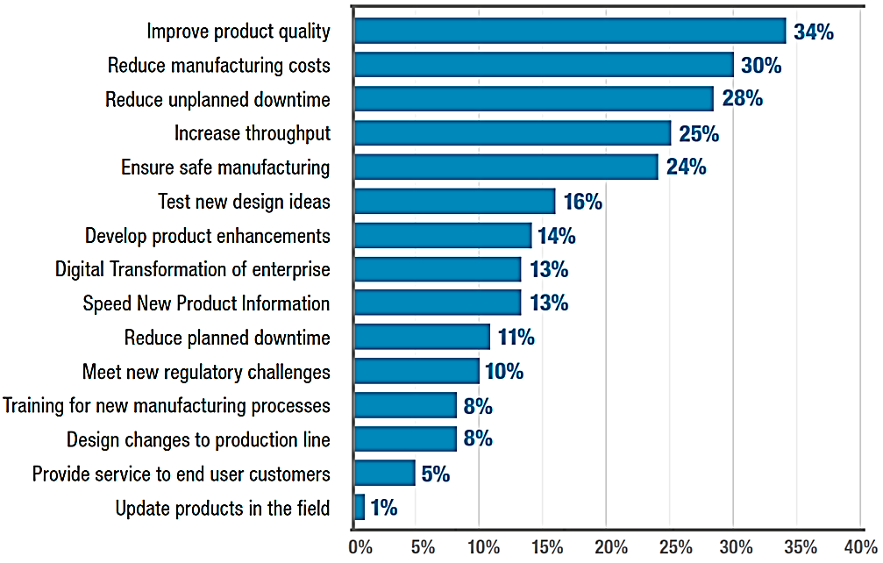
Introduction
Digital Twin Use Cases
Testing design prior to manufacturing
Diagnosing faults
Increases up-time and maximizes failure avoidance
Lower maintenance costs via predictive maintenance

Slide 3
Introduction
AI and Digital Twins
Mutualist relation; both contribute to each other
Digital Twins
Can generate simulated data to train data-hungry AI models.
Can virtually create an environment for AI test scenarios
Artificial Intelligence
Used to process large amounts of data collected from digital twins
Can accelerate the design process by evaluating many alternatives

Slide 4
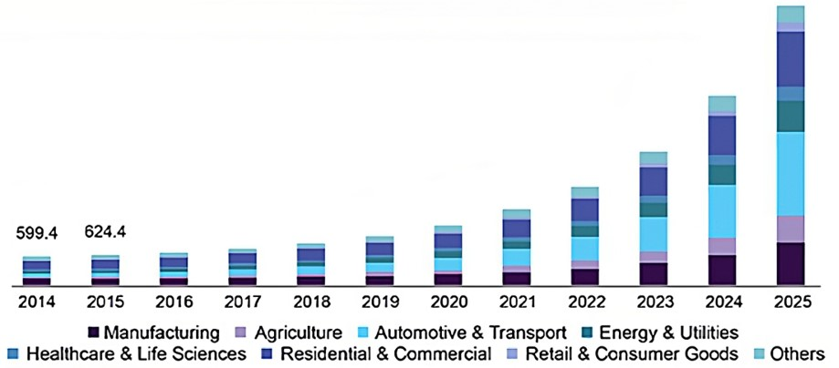
Adoption Prediction
Growing market share
Adoption by tech-giants
IBM
Siemens
Microsoft

Slide 5
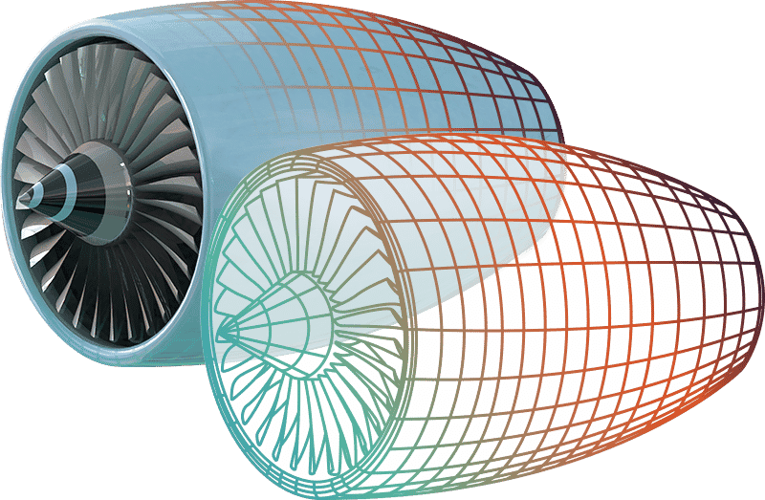
Digital Twin
What are Digital Twins?
Computer-based versions of anything that physically exists
Cloud based virtual image of your asset maintained throughout the lifecycle
Virtual copy of something real, modelled to behave realistically

Slide 6
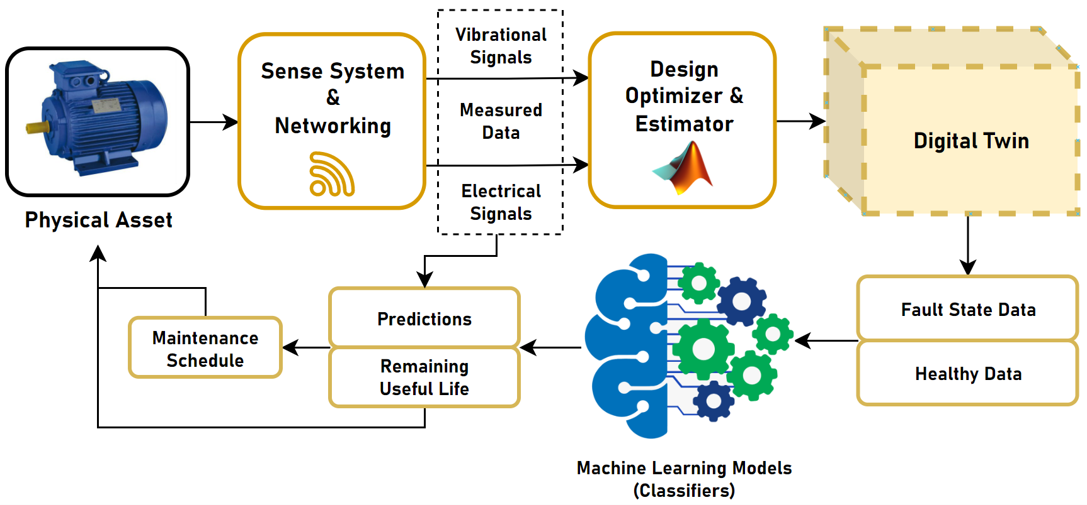
Block Diagram

Slide 7
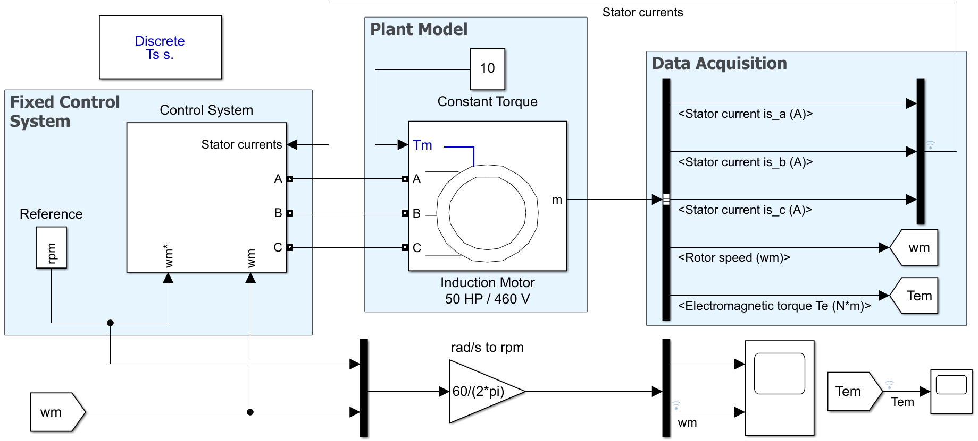
Model
Extracting stator current vectors
(electrical signal sensing)

Slide 8
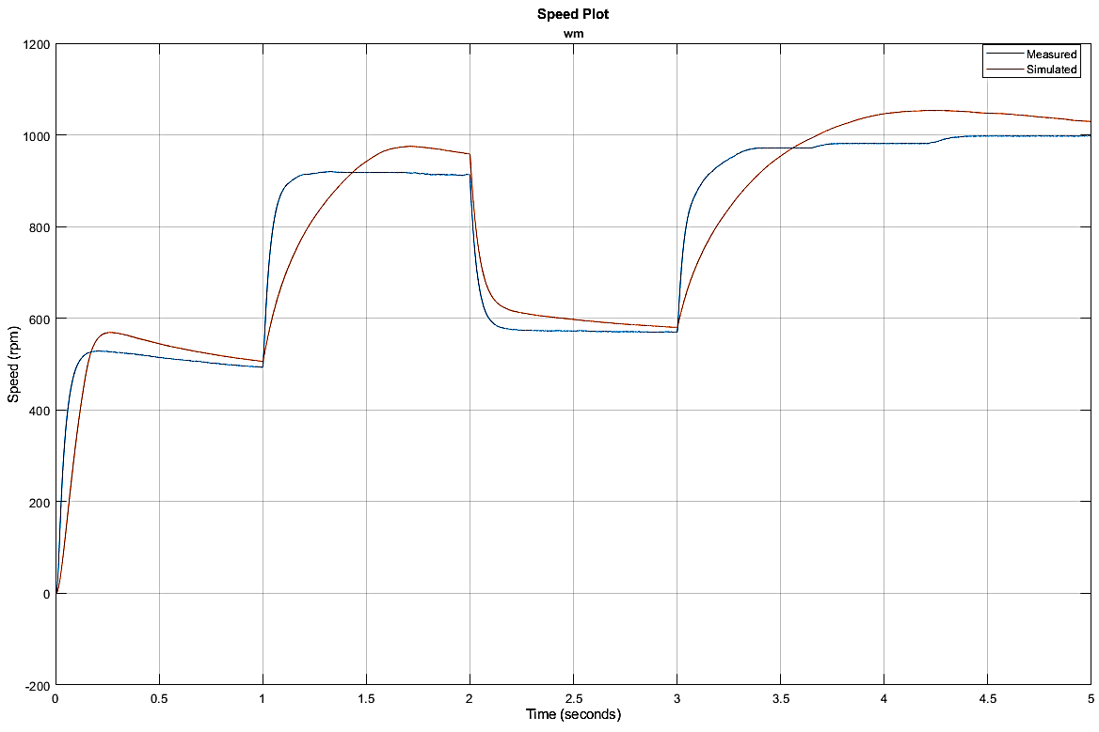
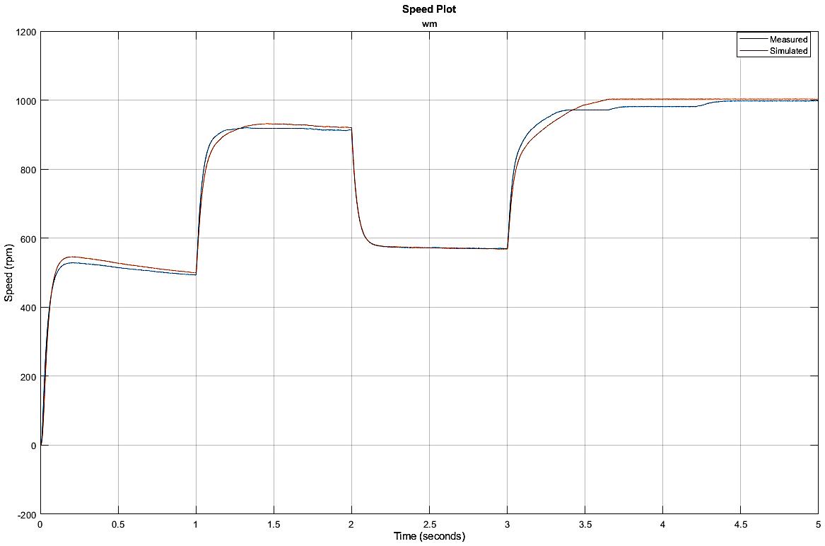
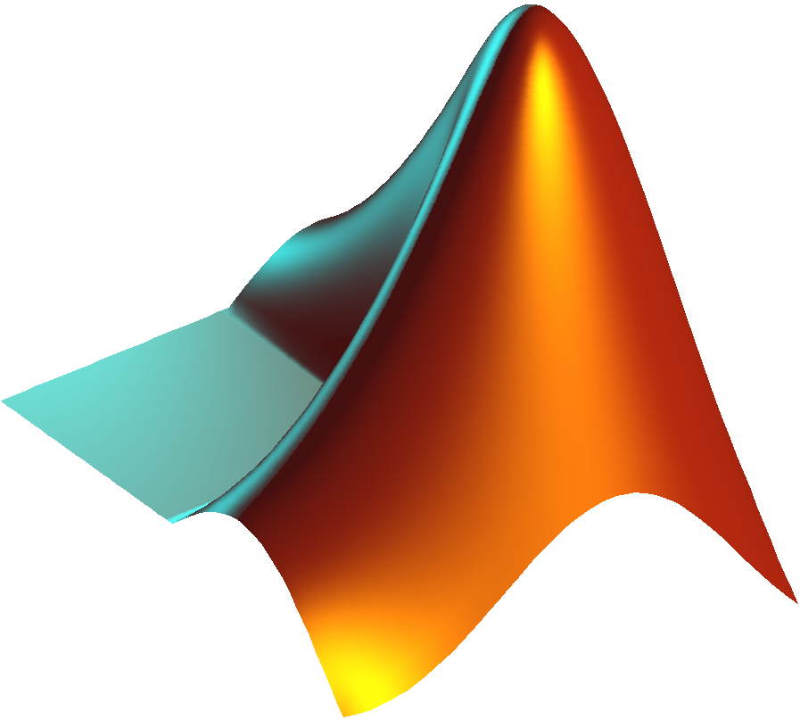

Parameter Estimation
Creation of a digital twin by updating parameters
{Resistances and Inductances of Rotor and Stator, Inertia and Friction factor of IM}
Design Optimization™

Slide 9
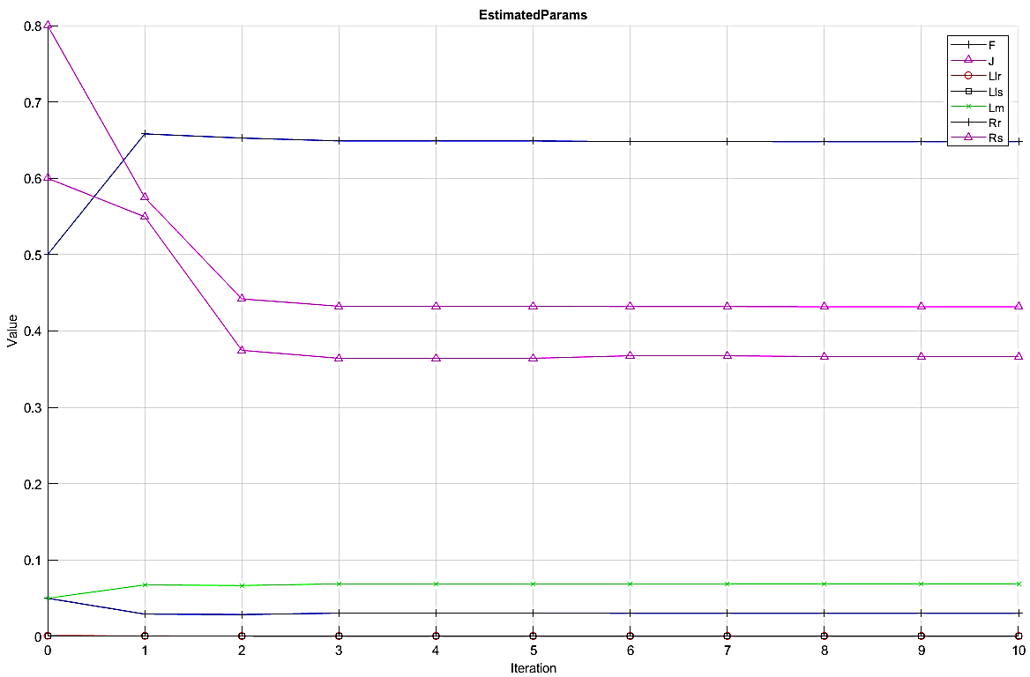
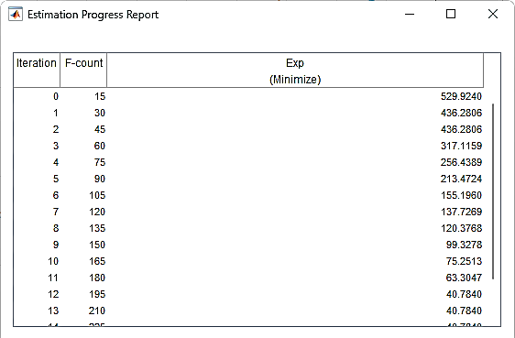
Optimization Report

Slide 10
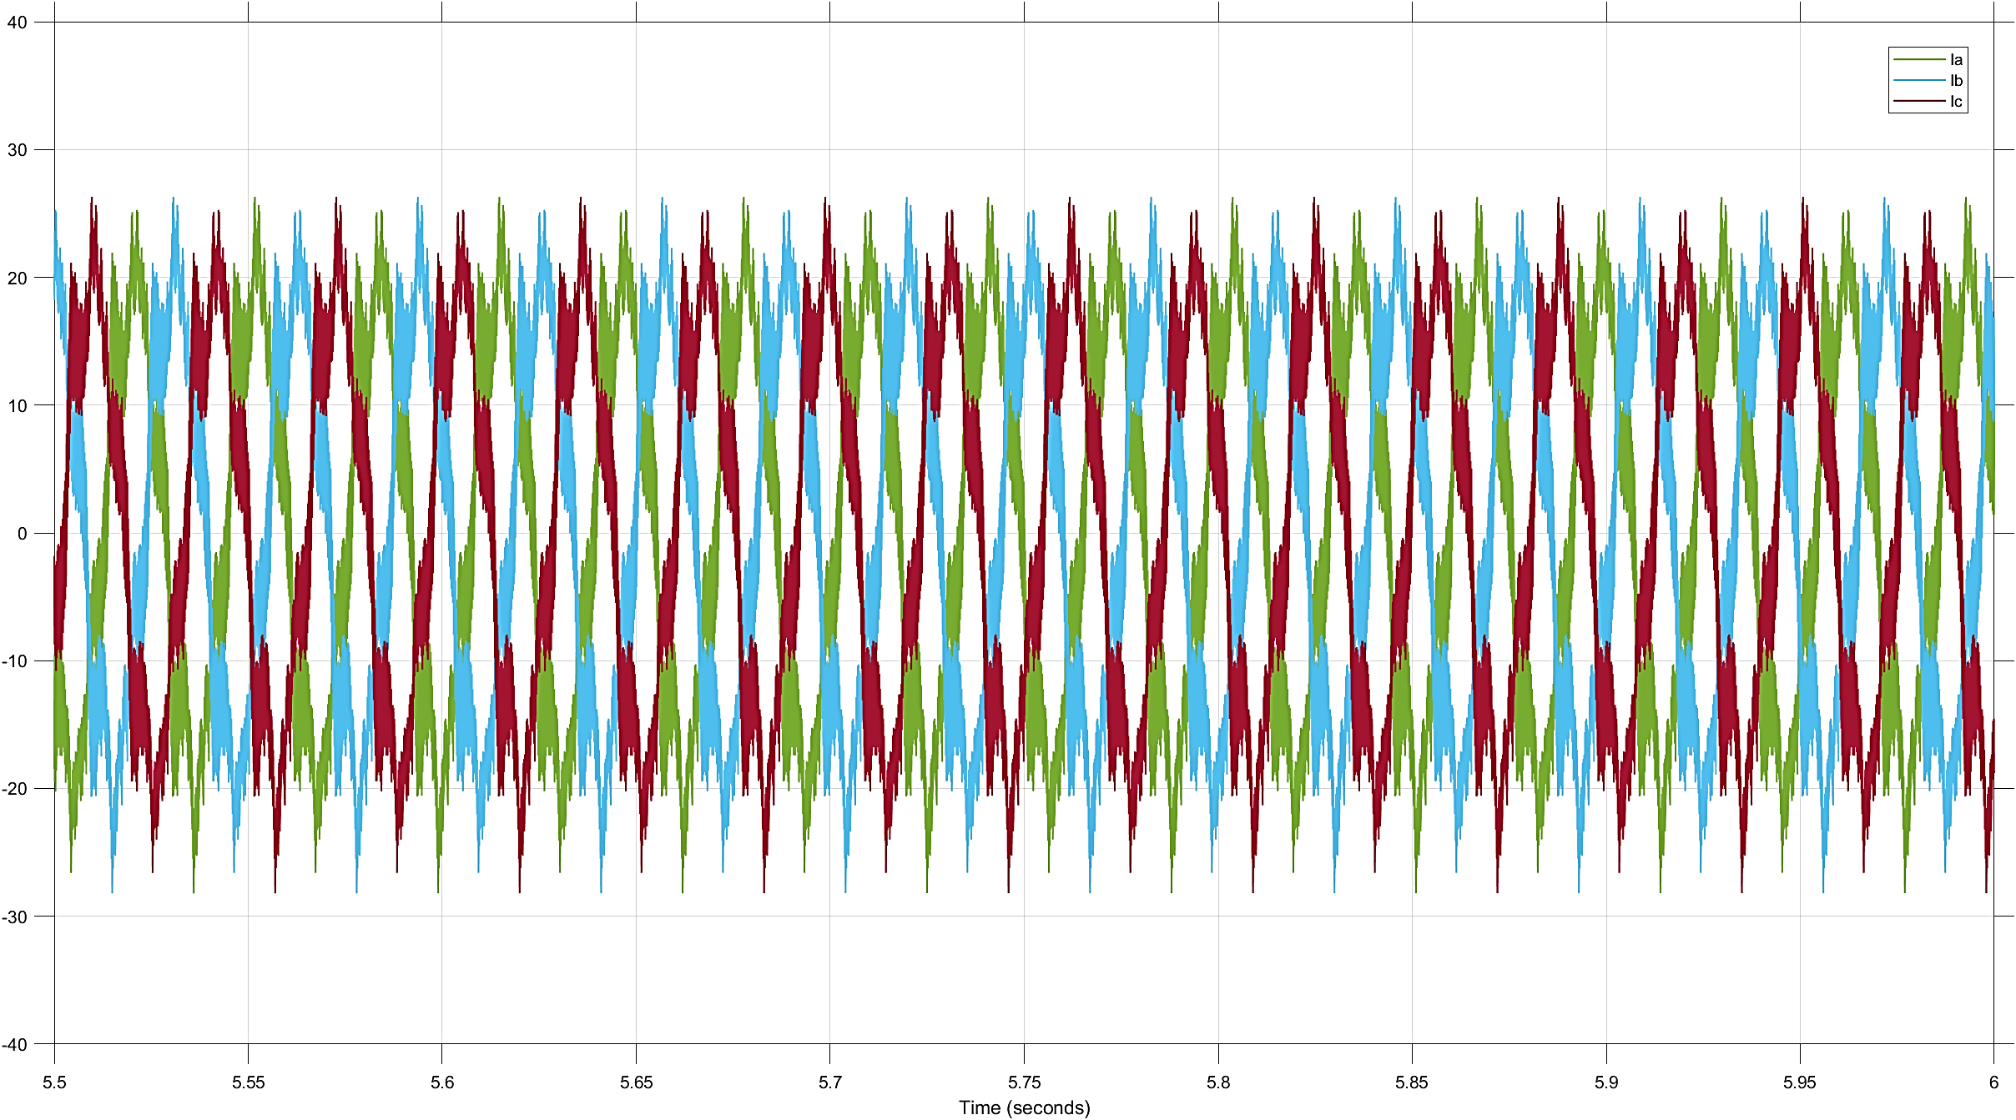
Electrical Signals
Using Simulink model to generate electrical signals
Power spectrum of the stator currents is obtained to perform statistical signal processing
Notes:
So now that we’ve made a digital twin of our physical motor, we can proceed onto the generation of faulty data. As mentioned previously, we use both electrical and vibrational signals to detect and classify faults. In electrical signals, we only use stator current of a single phase, as using three phase is both redundant, because each phase has the same features, and computationally expensive. Furthermore, a sinusoidal waveform will have no significant statistical features, so we work with its power spectrum instead.

Slide 11
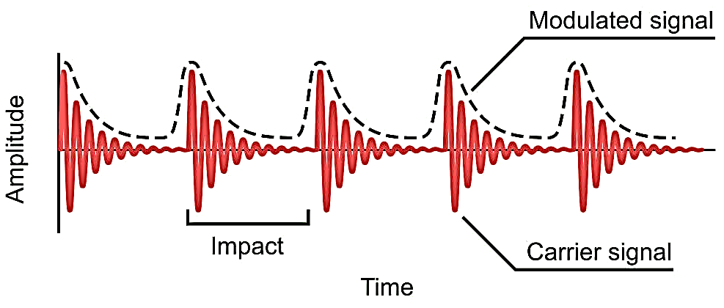
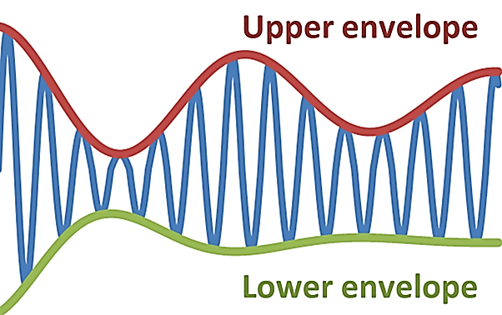
Vibration Signals
Using MATLAB Signal Processing Toolbox to estimate Rotating Machinery Vibrational Behavior, axial and radial vibration signals are generated
Signal envelope is used to minimize computation and avoid dealing with high frequency components
Notes:
Following the lines of electrical signals, vibrational signals, both axial and radial, are also generated by introducing faults in our digital twin. MATLAB has a built-in toolbox to estimate vibrational signals in rotating machinery, which we use to generate our data. After we’ve obtained such signals, we perform signal enveloping to get a modulated signal, getting rid of high frequency components that are detrimental to feature extraction.

Slide 12
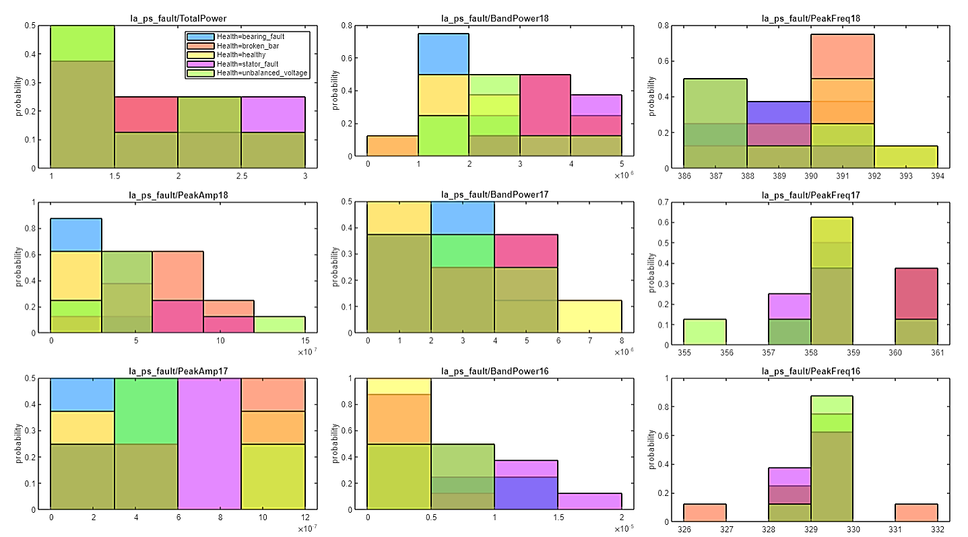
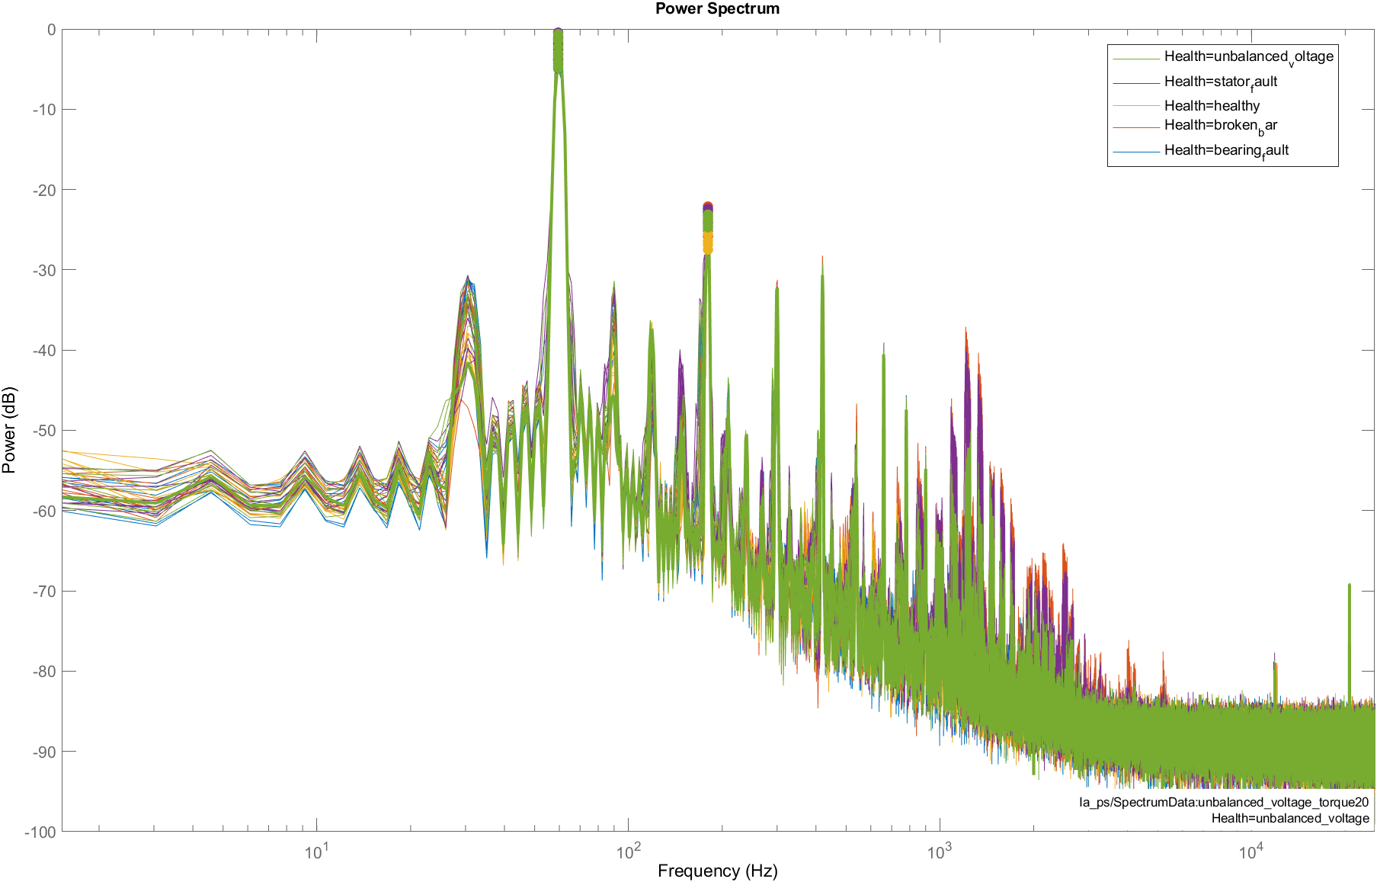

Feature Extraction (Stator Current $I_{a}$)
Notes:
This shows the power spectrum of the stator current, and as apparent from the figure, we cannot really deduce anything yet. So, we use feature extraction toolbox of MATLAB to get statistical values such as total power, band power, peaks, etc.

Slide 13
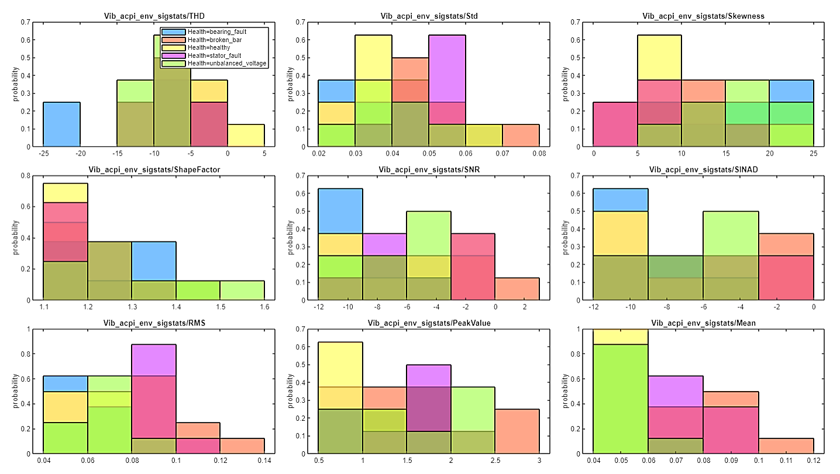
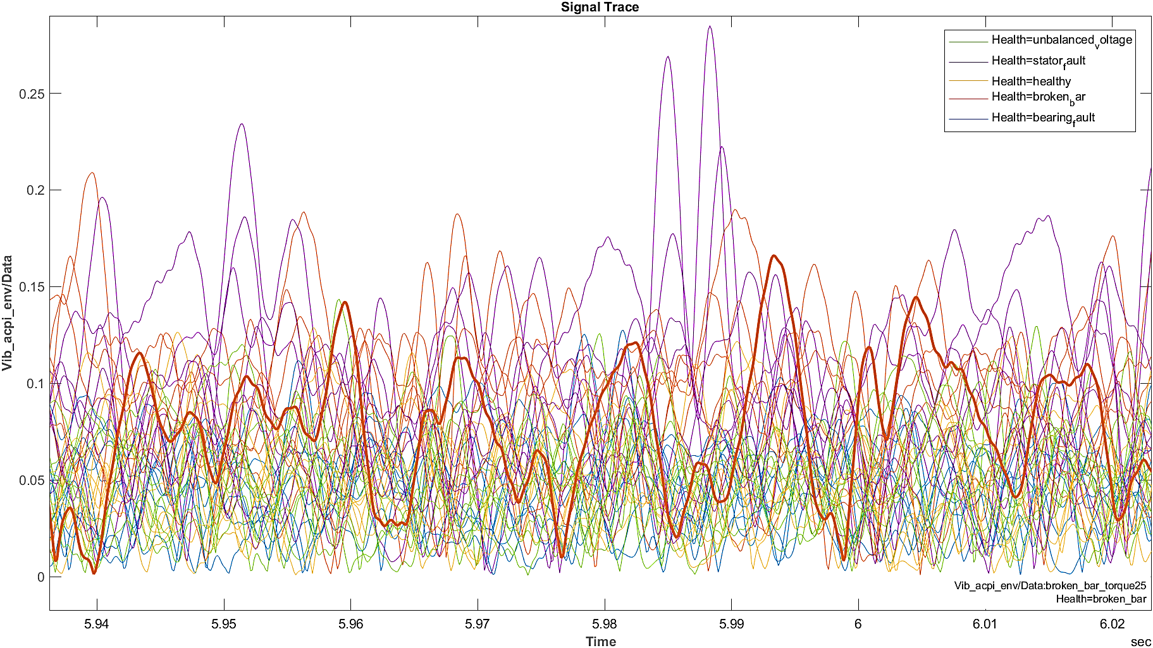
Feature Extraction (Radial Vibrations)
Notes:
Similarly, we extract such statistical features for both radial and axial vibrations using the same toolbox.

Slide 14
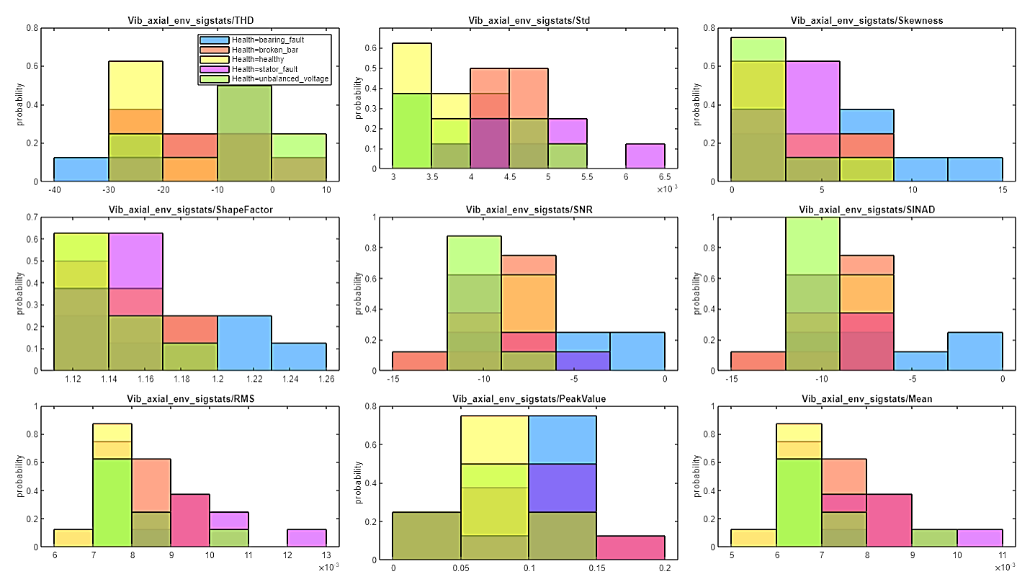
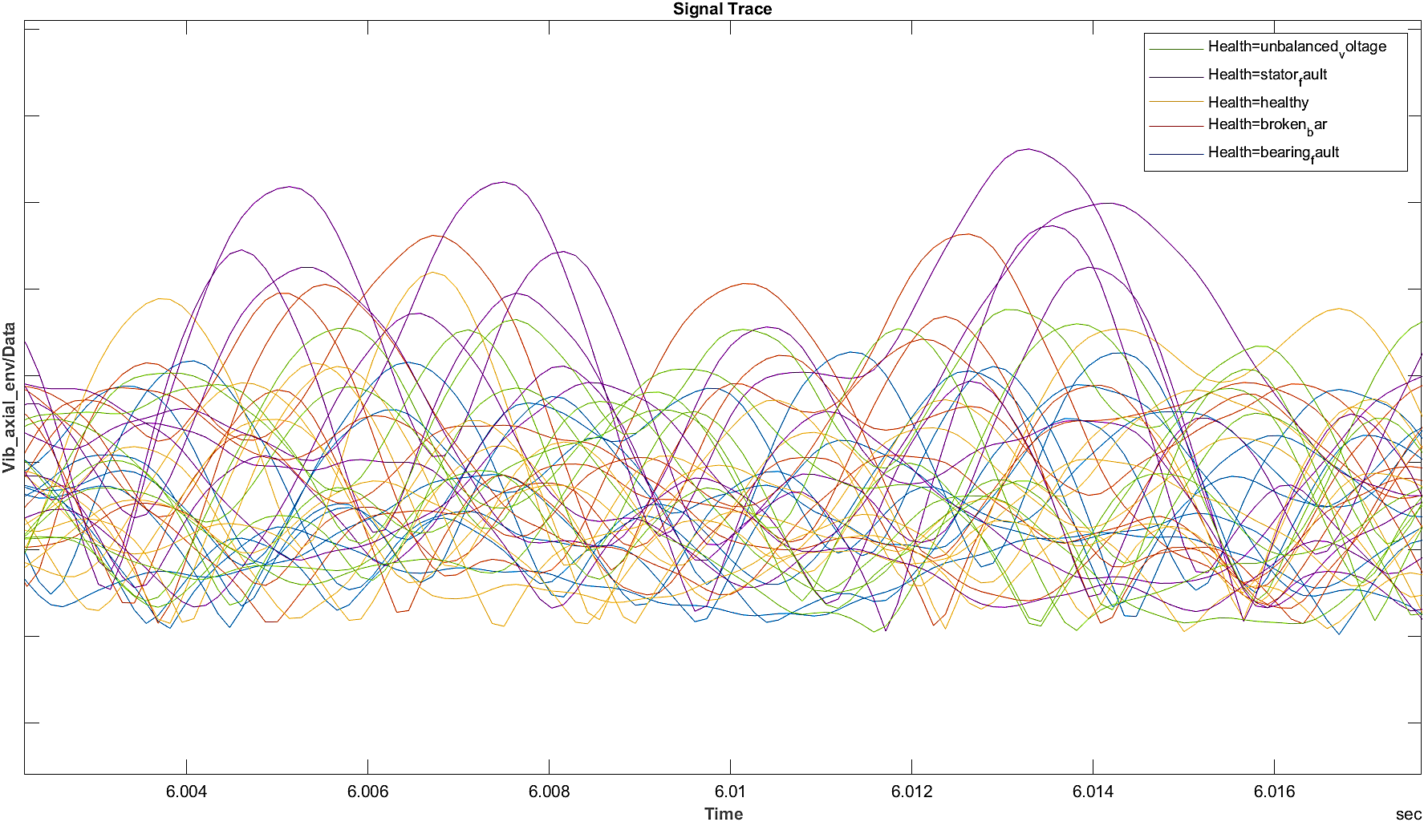
Feature Extraction (Axial Vibrations)

Slide 15
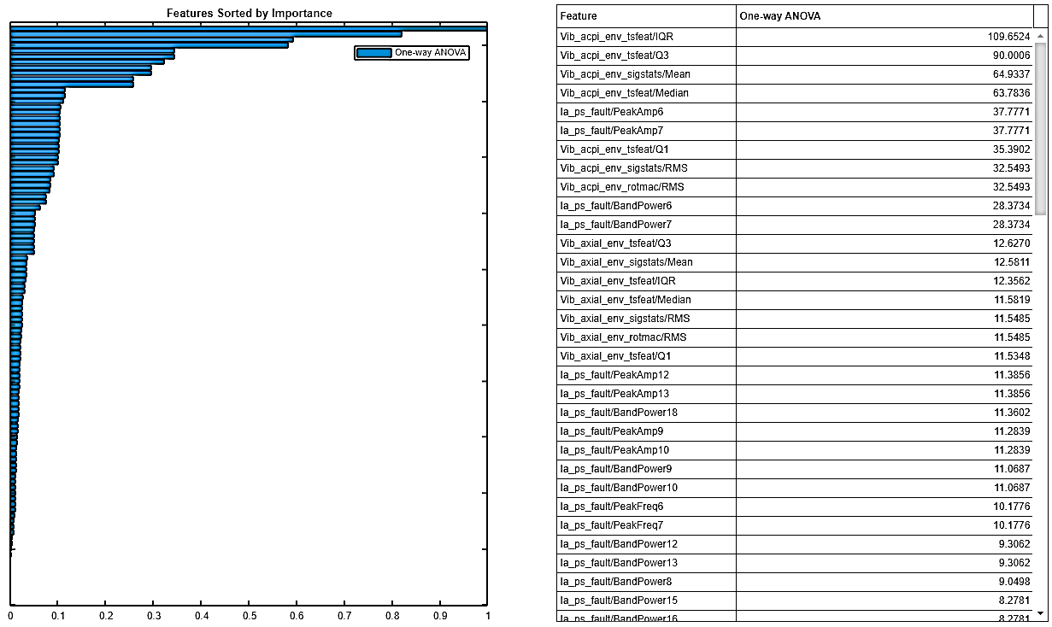
Feature Ranking
Ranking all extracted statistical features in order of their importance
Choosing the top 13 (arbitrary choice) important ones for training the ML classifiers
Too many unimportant features can penalize the model
Notes:
After all features have been properly extracted, we rank them in the order of their importance using one way analysis of variation, or ANOVA for short. The top features are then passed onto the machine learning classifiers for training. It should be noted that too many unimportant features can result in undesired effects, so out of 50-60 features that were extracted, only the most important ones were chosen.

Slide 16
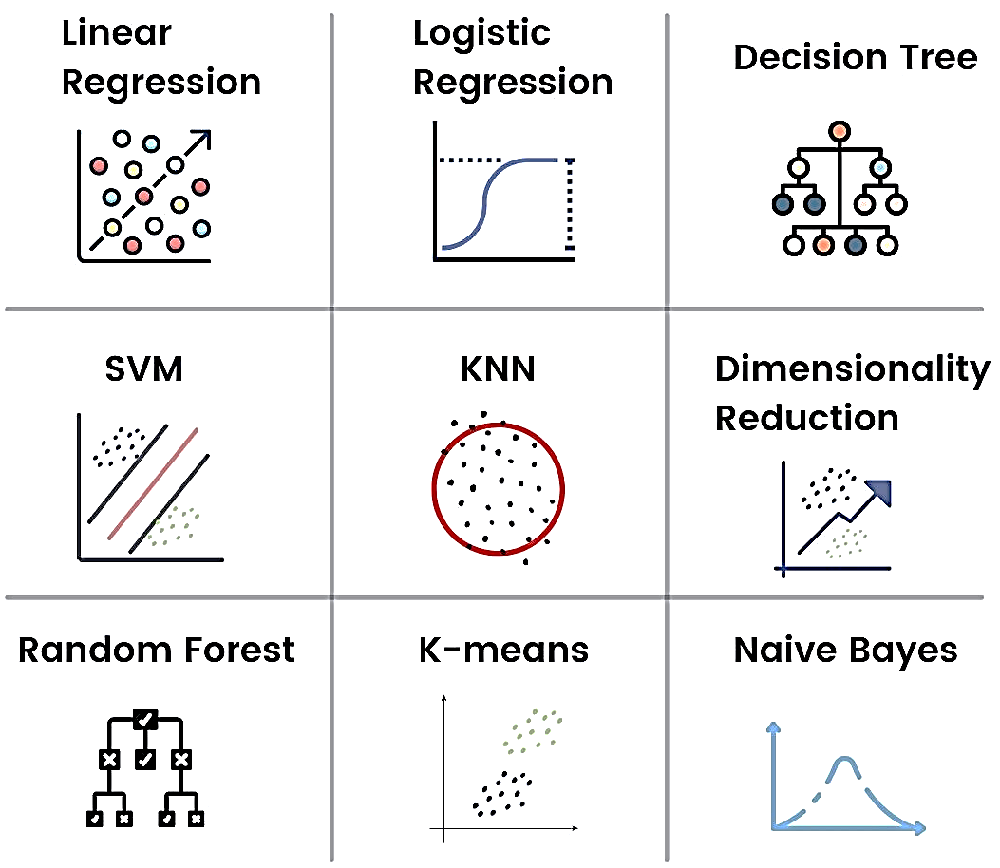
Machine Learning: Classifiers
Machine learning algorithm or mathematical function that maps input data to categories
Examples
Linear Classifiers
Quadratic Classifiers
Support Vector Machines
K-Nearest Neighbors
Neural Networks
Decision Trees

Slide 17
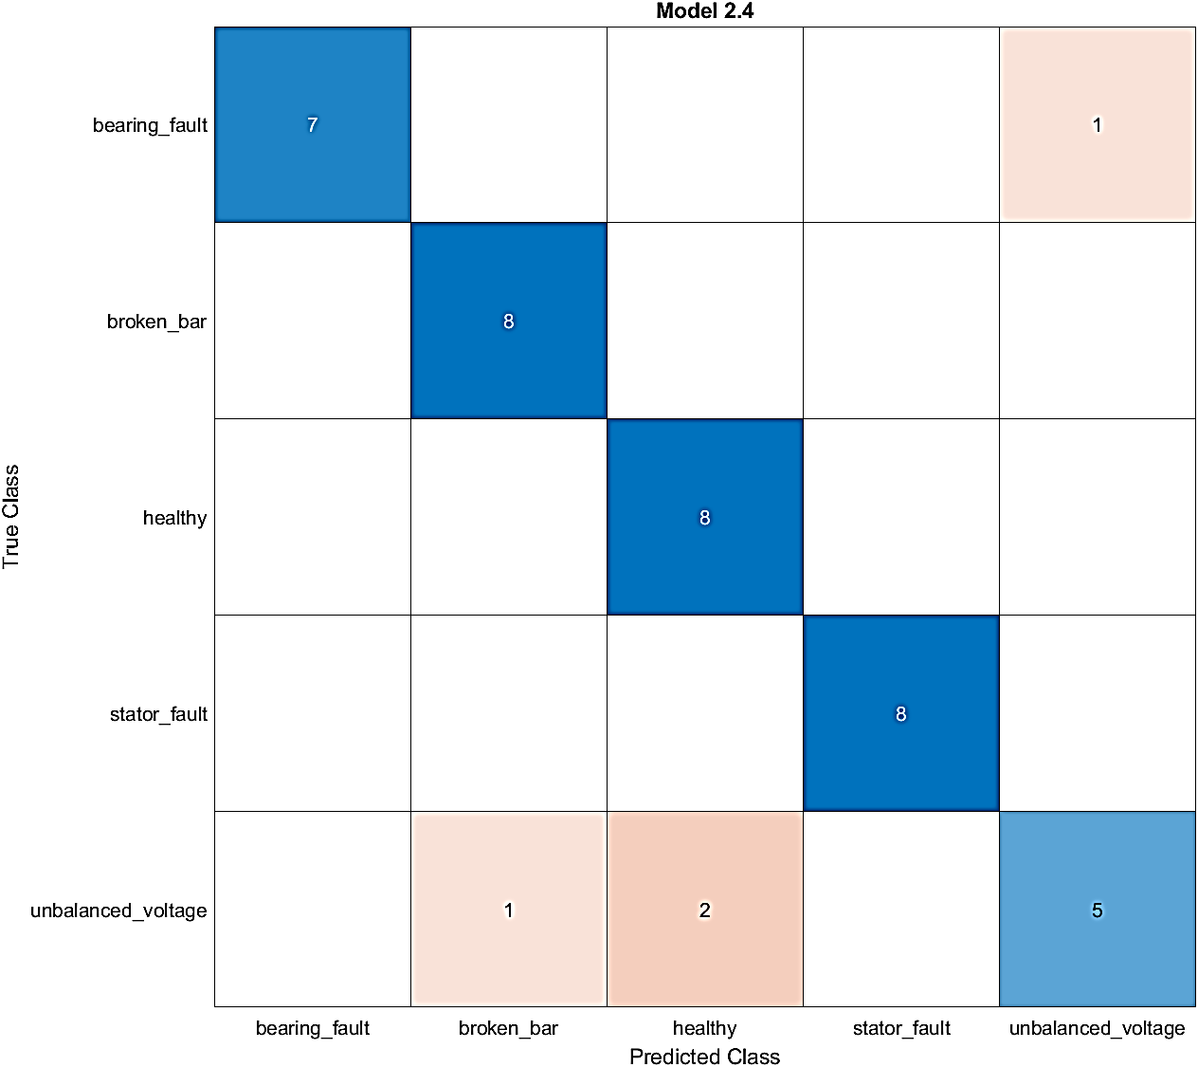
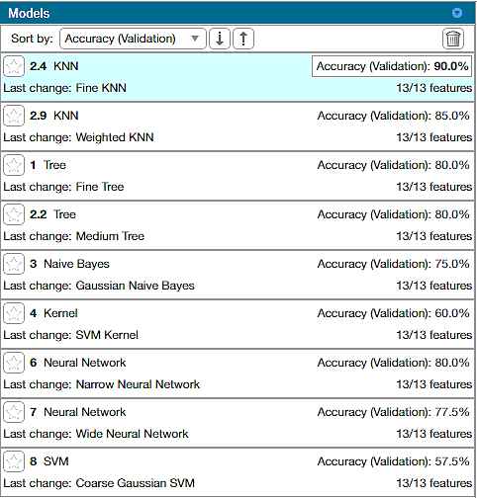
Predictions
Trained Models
Confusion Matrix

Slide 18

Challenges & Future Work
Collection of precise & accurate data from the hardware
Implementing the prototype onto a large-scale Industrial System
Training the model on larger fault data by running thousands of what-if simulations
Increasing the number of parameters for feature extraction
Mechanical torque variations
Stator magnetic field variations
Thermal signatures

Slide 19
Conclusion
Digital Twin is a virtual representation of a physical system
They can act as smart software drivers for physical assets via IoT
They allow for real-time analytics, feedback and implementation
They let you predict failures in advance and reduce downtime, do what-if simulations, and optimize operations

Slide 20
Member Contributions
Abubakar | Literature Review Researched existing literature
Syeda Fatima Zahra | Induction Motor Model Modelled the induction motor
Danial Ahmad | Parameter Estimation Created digital twin via design optimization
Muhammad Umer | Fault Generation & Feature Extraction Created faulty data and extracted statistical features for training the classifier
Muhammad Ahmed Mohsin | ML Model Training & Testing Trained the machine learning classifier and calculated the confusion matrix

Slide 21


References
Stocco, Flavio. "Digital Twin technology for induction motor drives." (2020)
Rassõlkin, Anton, Viktor Rjabtšikov, Toomas Vaimann, Ants Kallaste, Vladimir Kuts, and Andriy Partyshev. "Digital twin of an electrical motor based on empirical performance model." In 2020 XI International Conference on Electrical Power Drive Systems (ICEPDS), pp. 1-4. IEEE, 2020.
Lopes, Tiago Drummond, Adroaldo Raizer, and Wilson Valente Júnior. "The Use of Digital Twins in Finite Element for the Study of Induction Motors Faults." Sensors 21, no. 23 (2021): 7833.
What is a digital twin? | IBM
Digital Twin | MATLAB

Slide 22
Feedback
Thank You
Any Questions?

